Slide 1
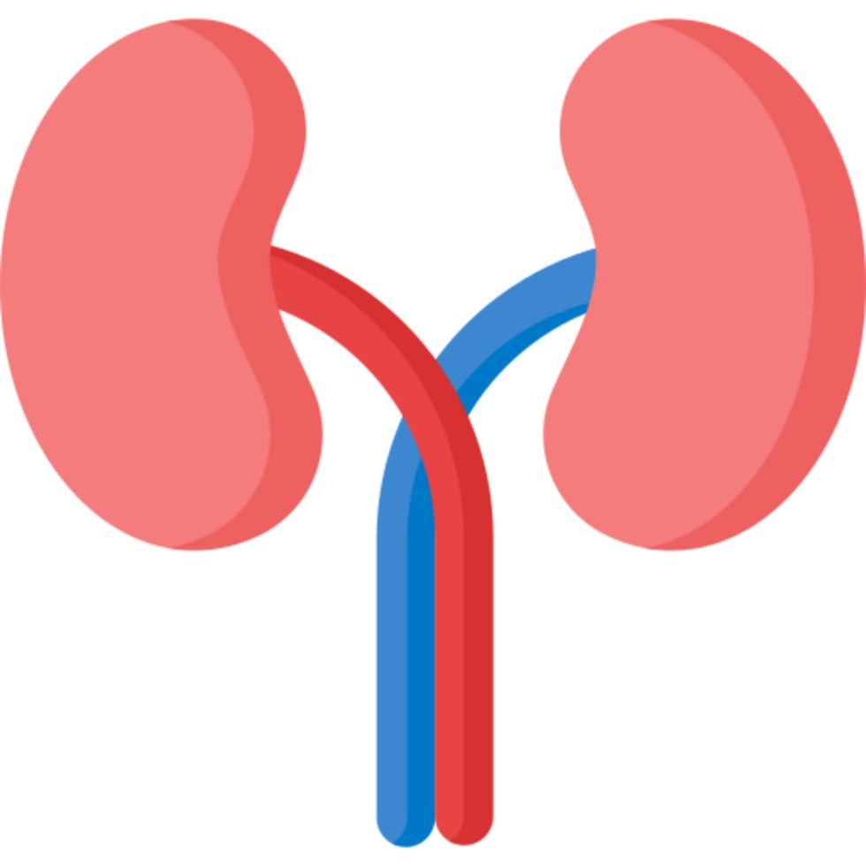
Predicting Chronic Kidney Disease: A Hidden Crisis
Why Early Detection Matters
ISDS 7075E • Group 3 • August 09, 2025
Davis Hanai, Michael Cali, Quynh-Tram Tran, Wynter Gray

Slide 2






Chronic Kidney Disease: Why It Matters
IRREVERSIBLE
CKD is irreversible. Early detection is critical.
1 in 7
U.S. adults have CKD
~35.5 million people
90%
don’t know they have it
Silent & undetected
MISSED SCREENING
Routine screening misses;
eGFR < 60 for > 3 months
1 in 3
adults with severe CKD
are unaware
LATE DIAGNOSIS
Symptoms appear too late
Dialysis, transplant, death

Slide 3
The Role of Predictive Modeling
Traditional Approach
🩸 Single eGFR measurement
⏱️ Reactive, diagnosis after symptomatic
📋 Limited variables assessed in isolation
🚨 Late-stage detection
🧍‍♂️ One-size-fits-all thresholds & treatment
🧪 Stage 3-5 CKD
Detected when eGFR < 60 > 3 months
*eGFR is often simplified to patients as a percentage of kidney function for easier communication.
Machine Learning Approach
👤 Age & Demographics
❤️ Vital Signs
🧪 Metabolic Panel
🩸 Complete Blood Count
💧 Urinalysis
🔗 Stage 1-2 CKD
Comprehensive + Early prediction
Notes:
What if we could predict CKD earlier using machine learning?
Models can analyze health markers (such as age, vital signs, metabolic panel, complete blood count, and urinalysis) to provide a comprehensive picture rather than isolated data points.
Earlier predictions enable timely care, better disease management, and reduced healthcare burden.
Slow the progression of the disease, delaying the time until patients require dialysis or a transplant.

Slide 4
The Benefits of Earlier CKD Detection
⏰
EARLIER DETECTION
Predict CKD risk years before traditional methods
🎯
TIMELY CARE
Proactive treatment and lifestyle intervention
💊
BETTER MANAGEMENT
Personalized treatment plans based on risk profile
Preventative Action
Lifestyle changes, monitoring
Slow progression
Better outcomes
Delayed dialysis/transplant
Quality of life preserved
🏥
REDUCED BURDEN
Lower healthcare costs and hospital admissions
⏳
SLOW PROGRESSION
Delay time until dialysis or transplant needed, waitlist
❤️
QUALITY OF LIFE
Maintain normal life longer with early intervention

Slide 5
Dataset, Goal, and Success Metric
📊
DATASET
400 patients with and without CKD diagnosis
🎯
GOAL
Predict CKD presence using Python + ML
🏆
SUCCESS METRIC
Accuracy > 0.90 on test set

Slide 6
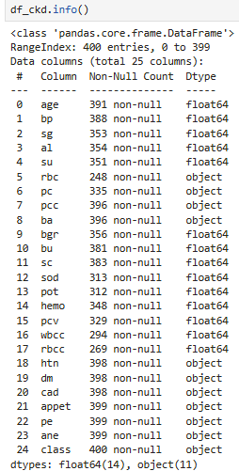
Exploratory Data Analysis (EDA)
24 variables
14 float64
11 object
1 outcome variable “class”: ckd or notckd

Slide 7
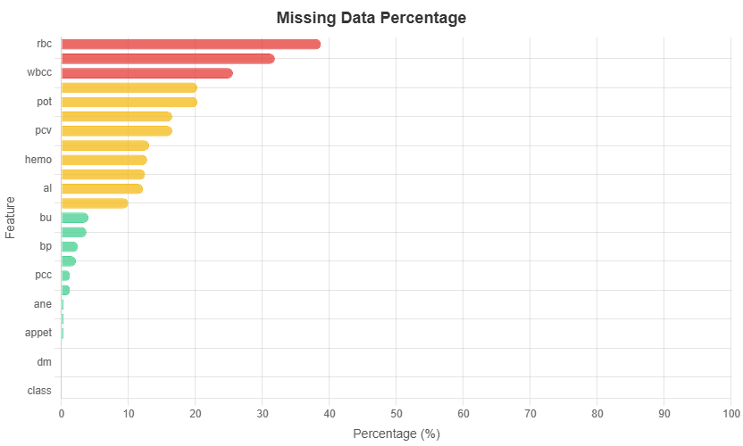
EDA: Missing Data and Data Quality Checks
Variables missing over 20% of values are:
(1) rbc
(2) rbcc
(3) wbcc
Notes:
In the initial data audit, we ran completeness checks and found that some lab values, such as red blood cells, red blood cell counts and white blood cell counts, were missing in over 25% of cases.

Slide 8
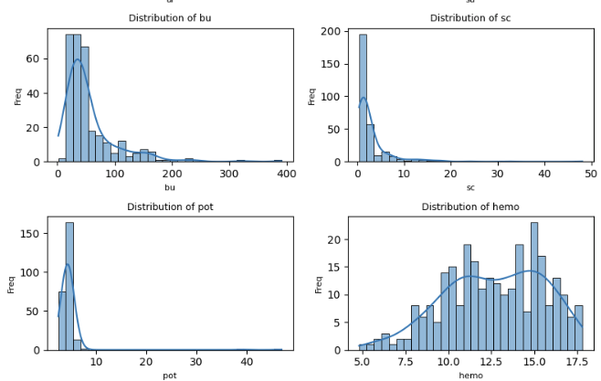
EDA: Distribution and Outlier Analysis
Plots of numeric fields are all skewed.
Due to skewness, missing values were imputed using median and not mean.
Notes:
In the initial data audit, we ran completeness checks and found that some lab values, such as red blood cells, red blood cell counts and white blood cell counts, were missing in over 25% of cases.

Slide 9
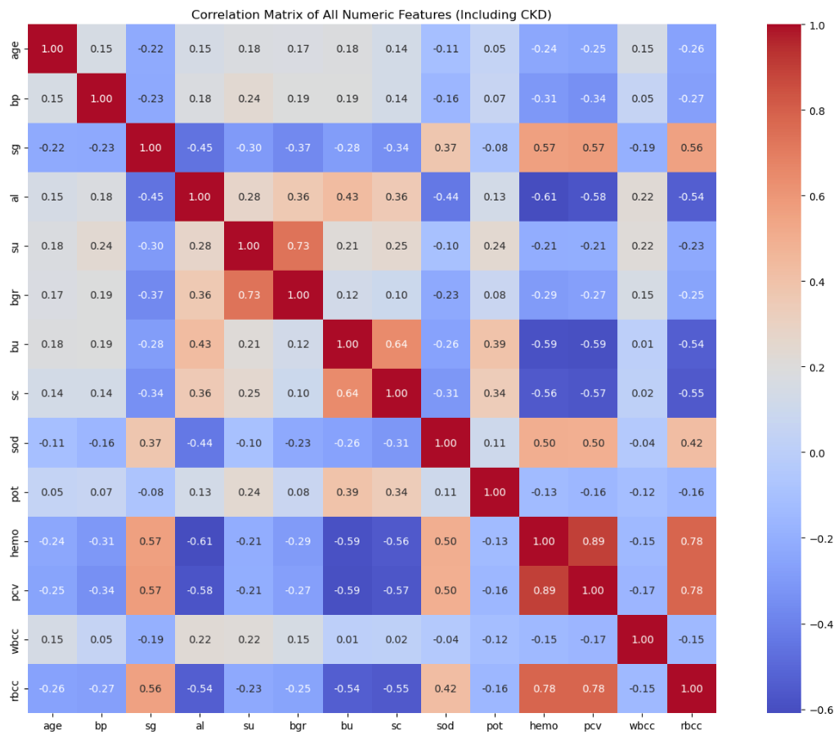
EDA: Correlation Matrix & Multicollinearity
Correlation matrix shows strong evidence of multicollinearity b/t:
0.89 - hemo and pcv
0.78 - hemo and rbcc
0.78 - rbcc and pcv
Hemo has strongest relationship with class, so rbcc and pcv were dropped.
Notes:
We then explored the distributions of our numeric fields, using histograms to check for skewness and boxplots to spot outliers. Nearly all numeric variables were skewed, so we chose median values—rather than means—for imputation, ensuring that extreme values didn’t distort our replacements. A correlation heatmap revealed strong relationships between hemoglobin, red blood cell count, and packed cell volume, which also guided our decision to remove some redundant variables."

Slide 10
Data Wrangling
Step | Description
1 🧹 | Dropped sparse columns (rbcc, rbc, wbcc, pcv)
2 ✂️ | Trimmed leading/trailing spaces from all text string
3 ❓➡️ | Replaced any “?” characters with NaN
4 🧩 | Filled missing values in numeric fields with medians
5 🔄 | Recoded categorical variable into TRUE/FALSE
6 ➕📊 | Imputed missing values in Boolean fields with mode
Notes:
For data wrangling, we applied a consistent cleaning pipeline to both training and test datasets. This included:
Dropping sparse columns (rbcc, rbc, wbcc, pcv)
Trim leading/trailing spaced from all text strings
Replacing ?? characters with NaN
Filling numeric missing values with medians from the training set
Recoding categorical clinical variables into True/False values, then changing data type to boolean
Imputing missing Boolean values with the most frequent category
By the end of this step, all missing values were addressed, categorical fields were standardized, and the dataset was in a clean, numerical format suitable for machine learning. This rigorous preparation ensured that any insights we draw are based on reliable, high‑quality data.

Slide 11
Predictive Modeling
📊Logistic Regression: Classification models which uses probability to determine the outcome If the probability is above a certain cutoff (0.5) then the answer is yes, and no if it is below | 📈Linear Regression: Machine learning technique which takes variable inputs and provides the outputs Draws a straight line through the data that best fits the points
🌳Decision Tree: Splits variable outputs with similar outcomes grouped together Like asking one expert for the answer Each answer narrows down the possibilities until the model arrives at a prediction | 🌲Random Forest: Many decision trees working together using ensemble learning (weaker models combined can create a stronger, more stable model) Like asking 100 different experts with different perspectives (data) and going with majority vote

Slide 12
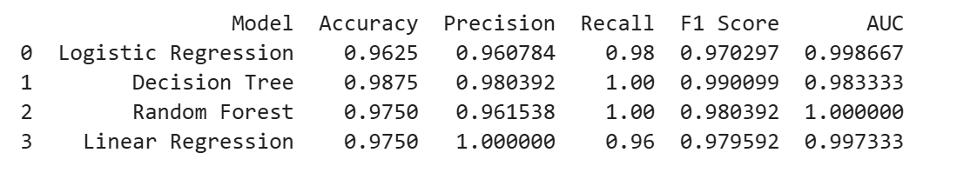
Best Model for Prediction
Perfect Recall🎯 of 1.00
(catches every + case)
Random Forest = 🏆
(ideal for CKD predictions)
Decision Tree Accuracy✅
(RF🌲 is more balanced since it’s less likely to overfit)
Perfect AUC 📈 of 1.00
(ranks + vs. - cases flawlessly)

Slide 13
Tuning
🔍 Tuning = Finding the best settings for the model (like number of trees 🌳, depth 🌊, and splits ✂️)
⚙️ GridSearchCV tests many combinations and picks the one with the highest accuracy 📈
✅ Best settings gave ~99% accuracy —
🔍 Tuned Random Forest = Highest Accuracy & Best Overall Performance 🏆

Slide 14

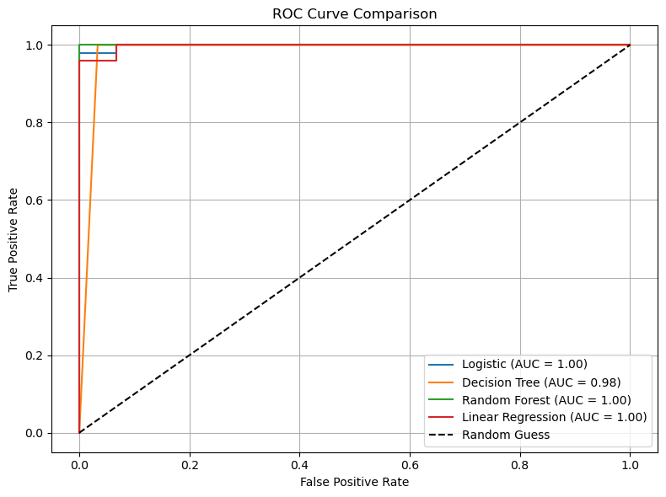
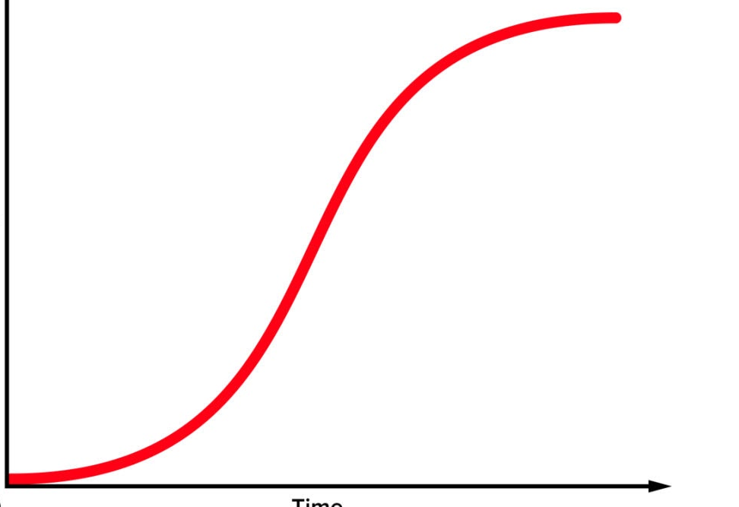
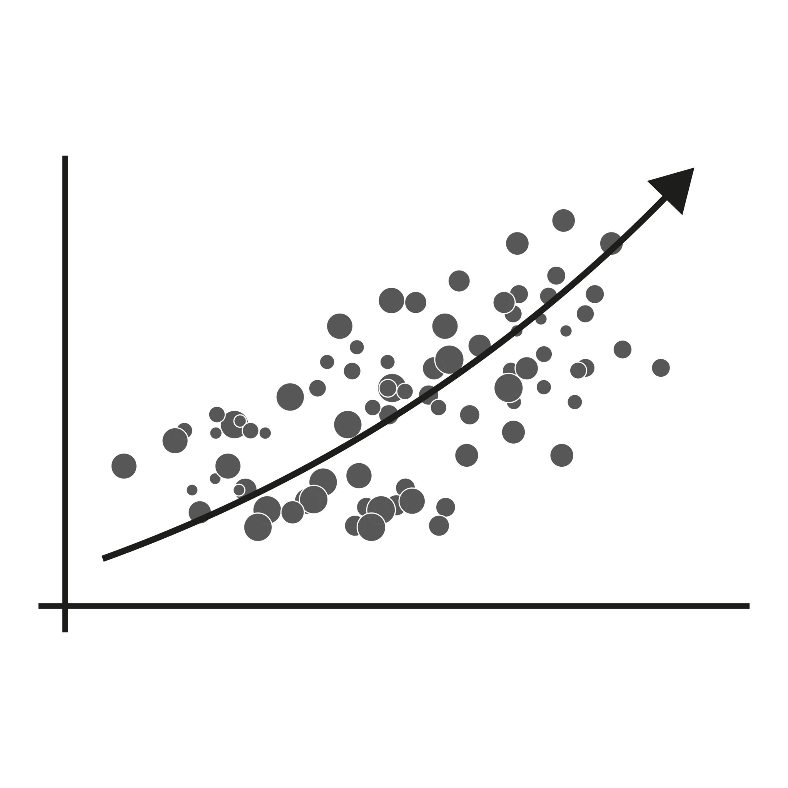
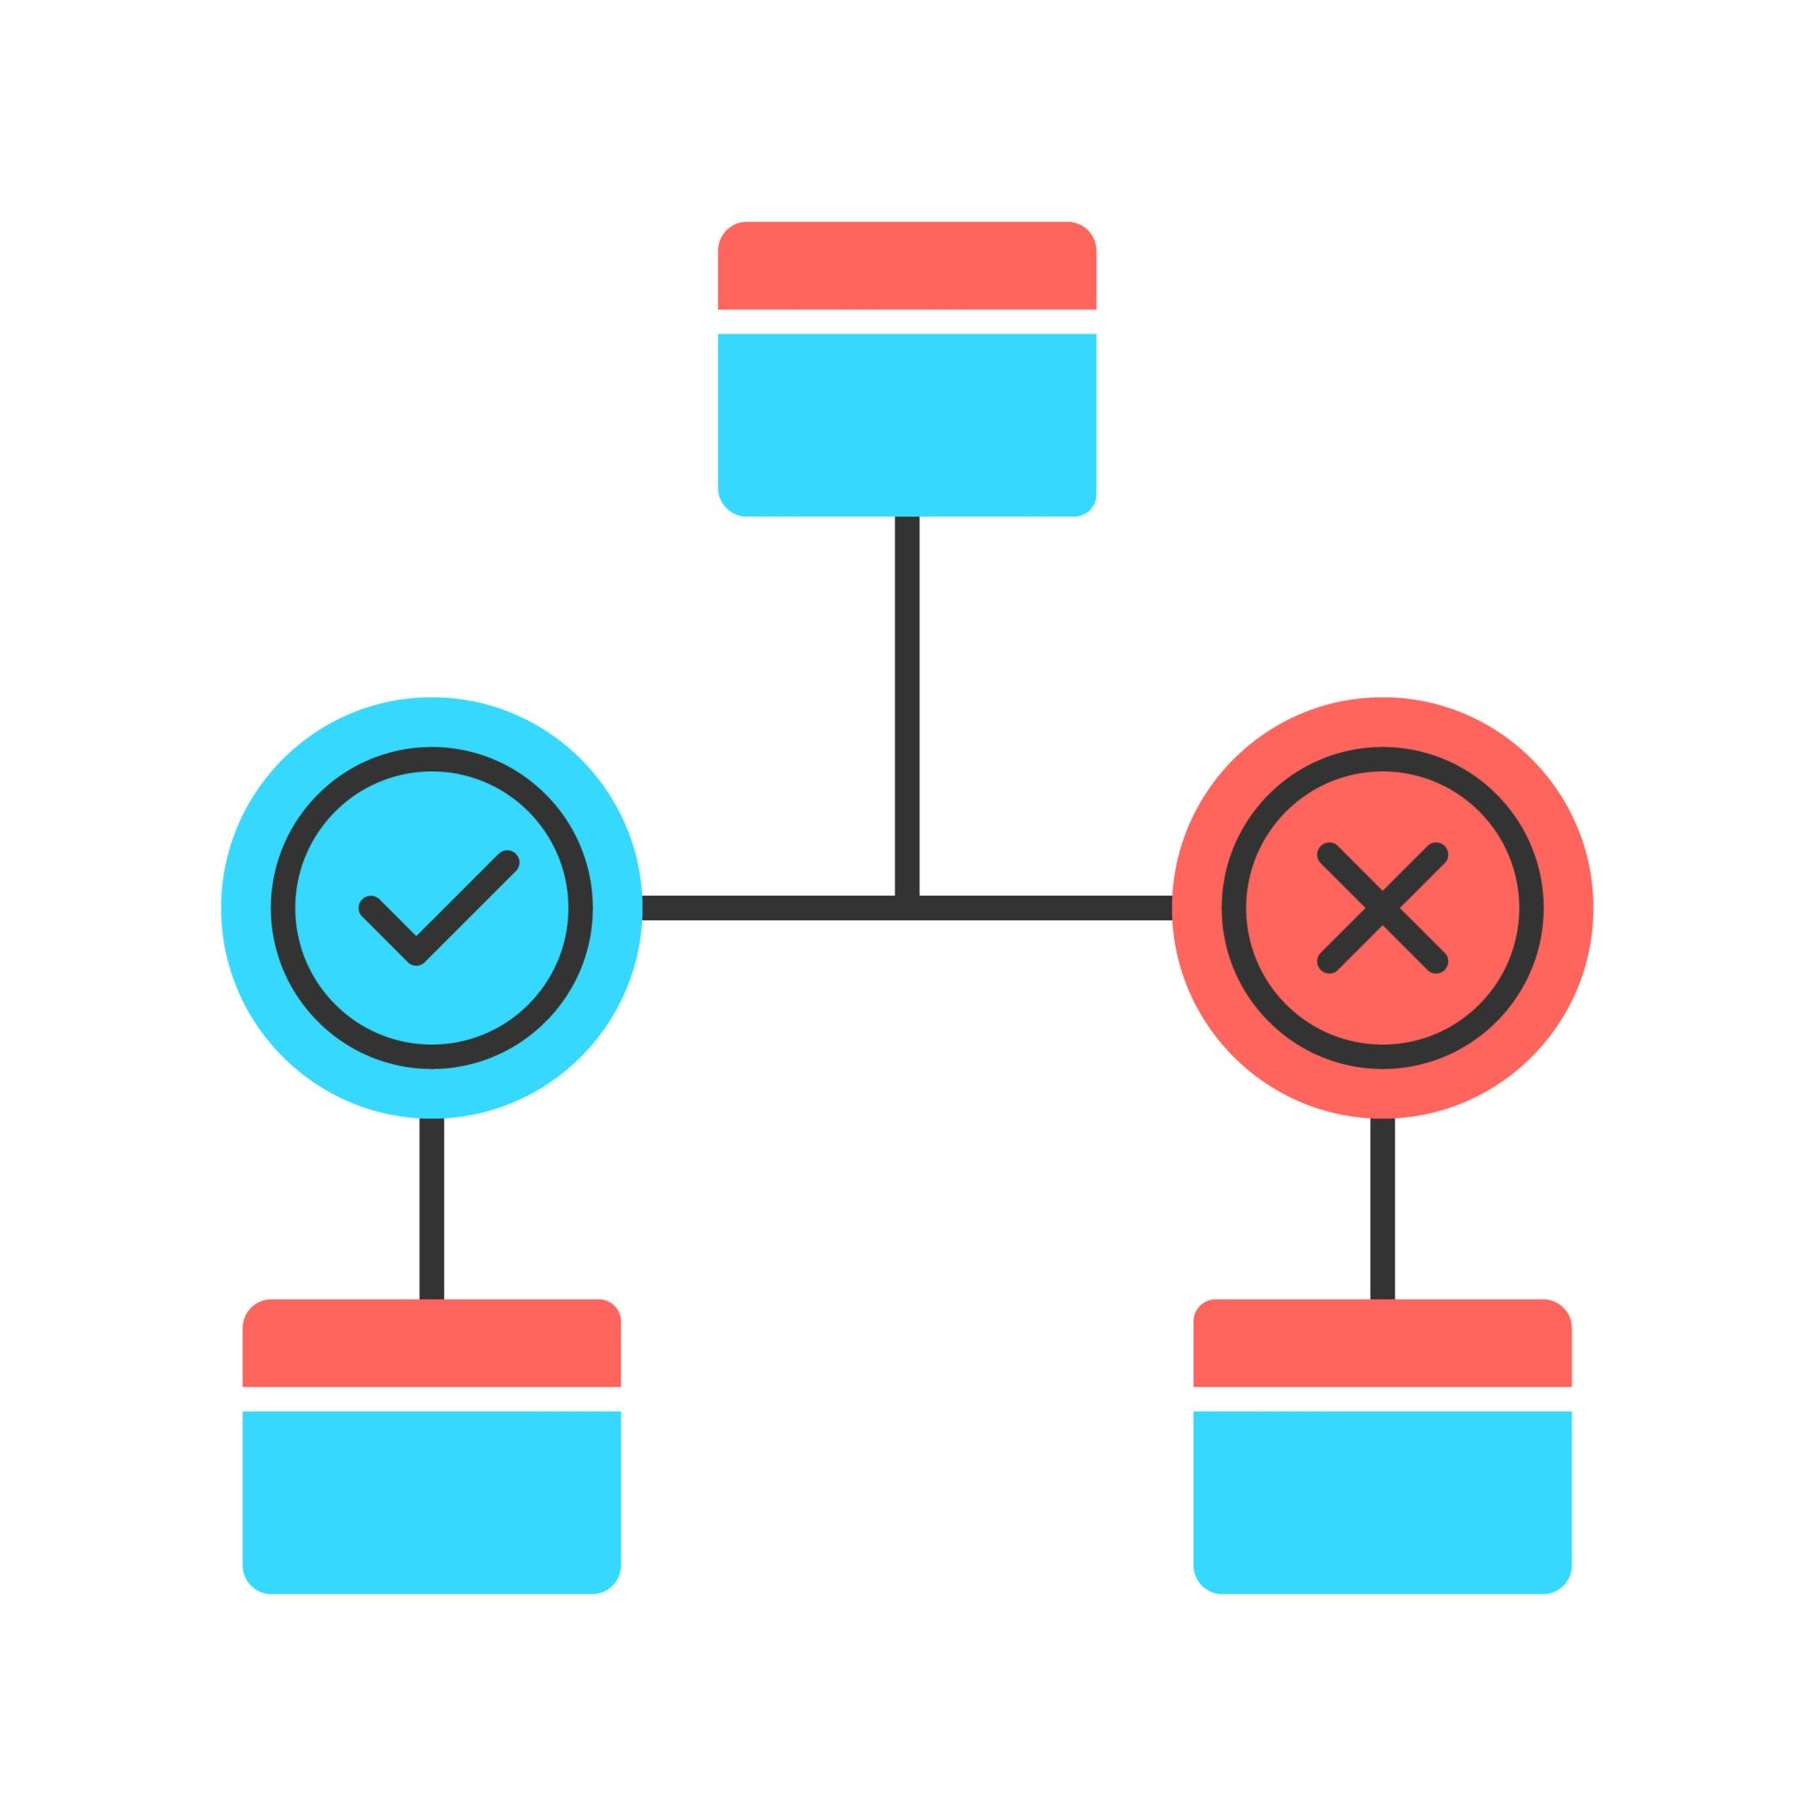
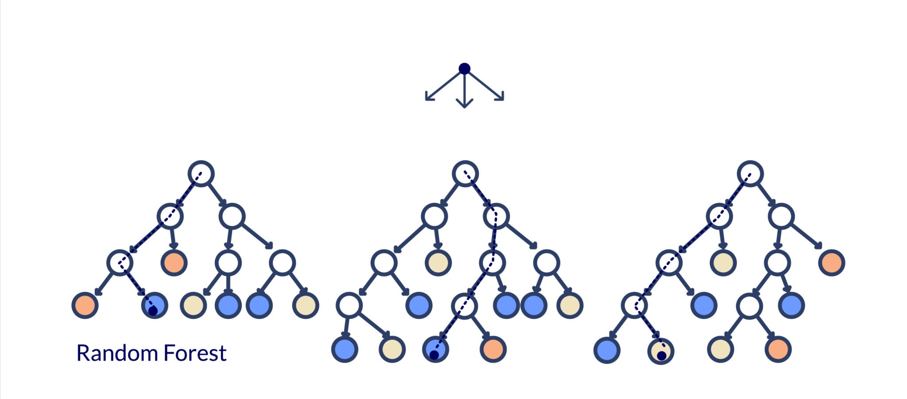
Step 7: Present Solution
Jupyter Notebook
Documentation can be found and reproduced through the dataset in the notebook
ROC Curve
Measuring how accurate each potential model can be
Logistic Regression
A classification model that uses probability to determine outcome
Linear Regression
A supervised machine learning technique that takes variable inputs to provide the output
Decision Tree
Splitting variables outputs and creating paths until a classification is achieved
Random Forest
Uses decision trees and ensembles them to reach a decision, while reducing overfitting
Notes:
While some of these facts may be reiterated from previous slides, they are deemed paramount when presenting to the mid-level managers. Documentation can be found in the Jupyter Notebook labeled “Group_3_Final_Project_Part_2.ipynb”
In the documentation, the model can be reproduced cell by cell with accompanying text to explain the findings within.
This notebook highlights the handling of missing data through median imputation, feature selection and engineering, data visualization, comparison of various models, and tuning of selected model (Random Forest).
The dataset is assumed to contain missing data, possibly incorrect data types, outliers, and correlated fields. A preliminary review of the dataset revealed numerous categories with a significant number of null values, especially noted in rbc, wbcc, and rbcc. The final model was built off the foundation of 400 rows of patients’ data and twenty-five columns that identify patients with or without chronic kidney disease (CKD), as well as accompanying laboratory results and comorbid conditions from a hospital in nearly a 2-month period. To allow for more collaboration, the original dataset from UC Irvine is used.
The measures of success for these models include generalizability, scalability, robustness, and ROC Area Under the Curve (AUC) comparison.The ROC curve illustrates each model’s ability to distinguish between CKD and non-CKD cases. All measures were satisfied by multiple models.
Four models were evaluated—Logistic Regression, Decision Tree, Random Forest, and Linear Regression—using a dataset of 400 patients. Each model was assessed based on accuracy, precision, recall, F1 score, and AUC.
Random Forest was selected for its better performance and scores against measures of success.
The Random Forest model was tuned using GridSearchCV to avoid overfitting.

Slide 15
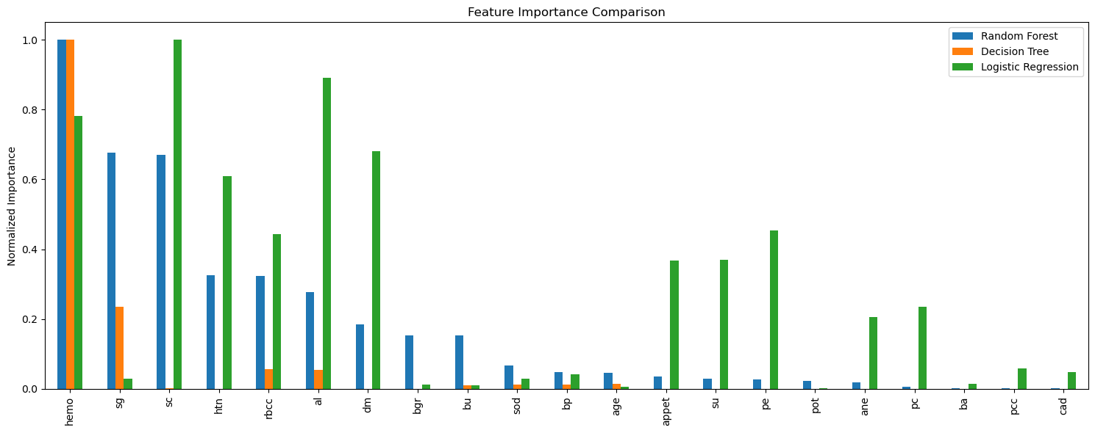


Step 7: Present Solution
Feature Importance
A feature importance analysis was conducted to identify the most significant variables in making a prediction
Hypertuning Parameters
Hyperparameter tuning with GridSearchCV validated the model's generalizability and accuracy
Limitations
Not including some advanced techniques like Neural Networks, Ensemble Models, Boosted Trees, and limitation of knowledge into TensorFlow
Notes:
A feature importance analysis was conducted to identify the most significant variables in making a prediction.
For the chosen Random Forest model, the most important features seem to be hemo (hemoglobin), sc (serum creatinine), and sg (specific gravity).
These models were iterated on and refined variable choices, feature selection, and feature engineering to improve performance.
By collecting the necessary data and compiling it into a single chart, Random Forest seems to be the most accurate and best fits the requirements of all compared models.
Hyperparameter tuning with GridSearchCV validated the model's generalizability and accuracy. The dataset was surprisingly highly suitable for prediction with high accuracy scores (>96% across all tested models).
While the risk of overfitting was a concern due to the high scores, this was addressed through extensive tuning and refinement, mainly through the hyperparameter tuning of GridSearchCV.
While many attributes of this model worked, such as the imputation and feature selection, the analysis contained some limitations and attributes that did not work, such as not including some advanced techniques like Neural Networks, Ensemble Models, Boosted Trees, and limitation of knowledge into TensorFlow.

Slide 16
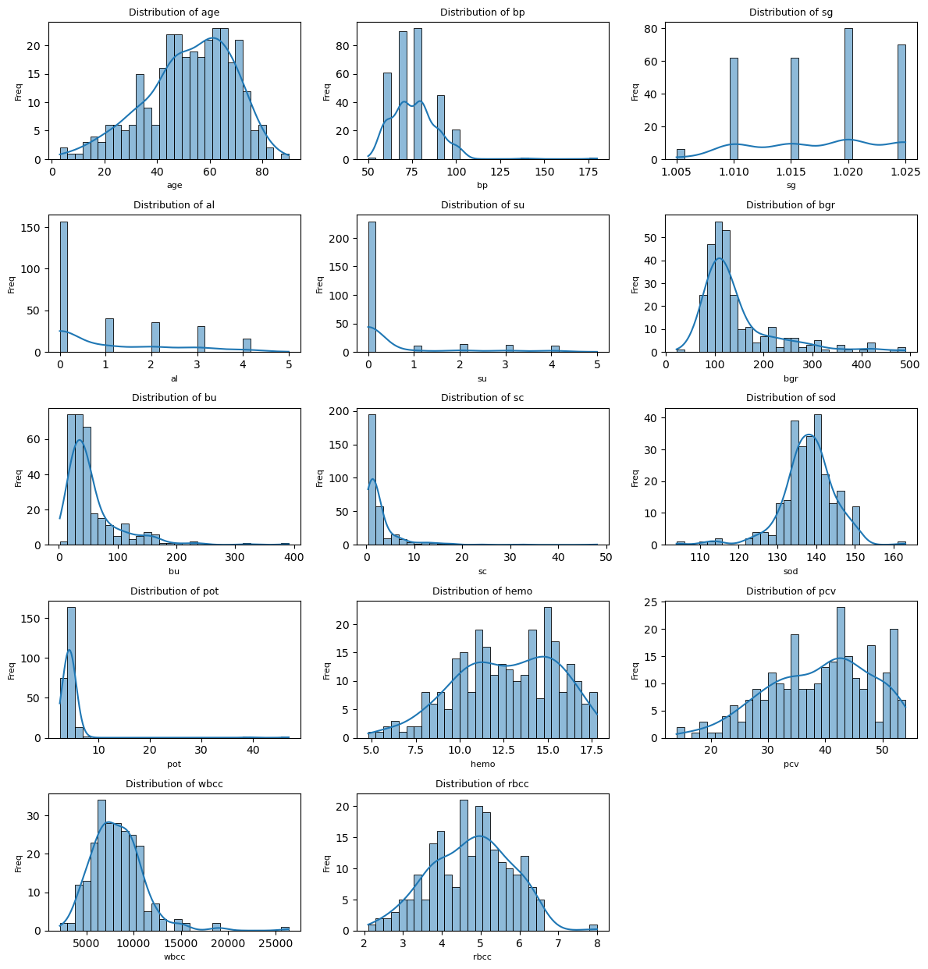
Step 7: Present Solution

Slide 17
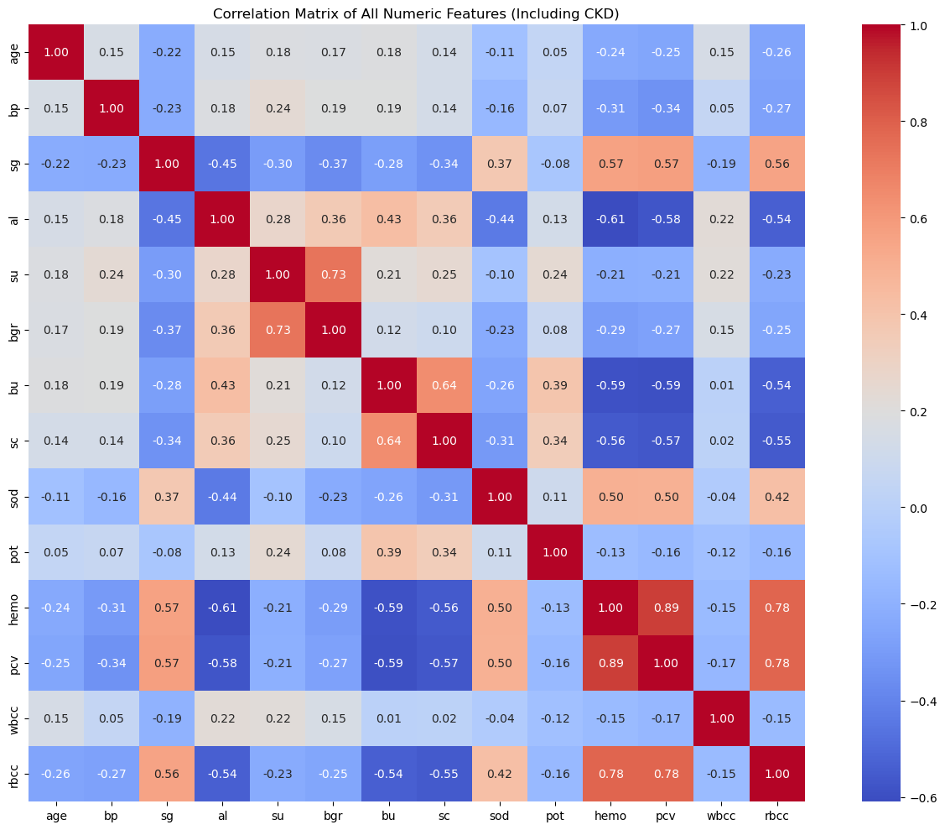
Step 7: Present Solution

Slide 18
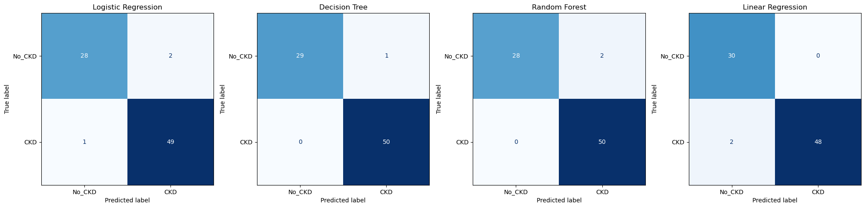
Step 7: Present Solution
Model Accuracy Precision Recall F1 Score AUC
0 Logistic Regression 0.9625 0.960784 0.98 0.970297 0.998667
1 Decision Tree 0.9875 0.980392 1.00 0.990099 0.983333
2 Random Forest 0.9750 0.961538 1.00 0.980392 1.000000
3 Linear Regression 0.9750 1.000000 0.96 0.979592 0.997333

Slide 19



Step 8: Launch
Github
The notebook is held in a GitHub repository and would be accessible to the appropriate personnel. This also allows for future changes if further tuning is needed and ability to replicate the model
Retraining and Refreshing
The model and data is refreshed, retrained, and continuously monitored for any potential changes. Maintaining the model's relevance and accuracy
Life Saver
Through the Launch process, lives can be saved from this incurable disease and early detection can be achieved
Notes:
Utilizing this notebook aligns with the goal of creating the model: Early detection of CKD using patients’ historical data.
The model is transformed to be ready for use in the hospital.
The notebook is held in a GitHub repository and would be accessible to the appropriate personnel. This also allows for future changes if further tuning is needed and ability to replicate the model.
After deployment, it is essential to automate the monitoring of the model's performance.
Tracking input data quality and any reduction in performance.
After tracking, the model and data is refreshed, retrained, and continuously monitored for any potential changes
This maintains the model's relevance and accuracy as new patterns may emerge. Retraining should take place as often as the hospital deems necessary.
Through the Launch process, by identifying at-risk patients earlier, the model contributes to improved clinical outcomes, reduced hospital burden, and potentially life-saving interventions.

